Slide 1
Alternative Finance for businesses
www.choicebusinessloans.co.uk

Slide 2
One key message today
Just because your bank can’t give you the finance you need,
it doesn’t mean you can’t get it elsewhere. There are alternatives.

Slide 3
Definition of Alternative Finance
“
...funding not traditionally
offered by the High Street banks
”
NB This does not compete with High Street Banks,
it is complementary to them
Mainly about providing funds where banks
will not or cannot

Slide 4
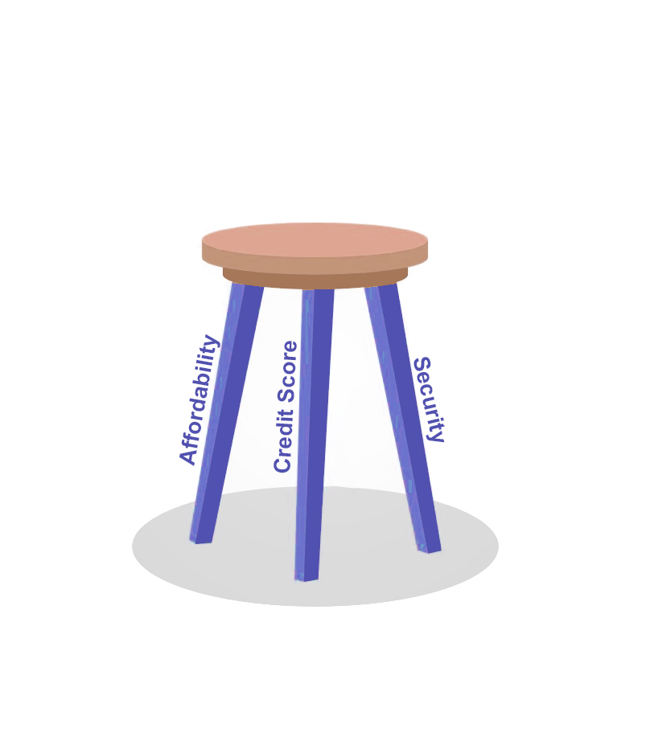
How a bank looks at a loan request
Three Key Parts:
1. Affordability
2. Credit Score
3. Security

Slide 5
Affordability
Bank
Multiple years of profit required
Credible forecasts
Alternative lenders:
More recent profitability acceptable
Lower debt cover threshold to achieve
Sometimes not required e.g. for Non
Status loans

Slide 6
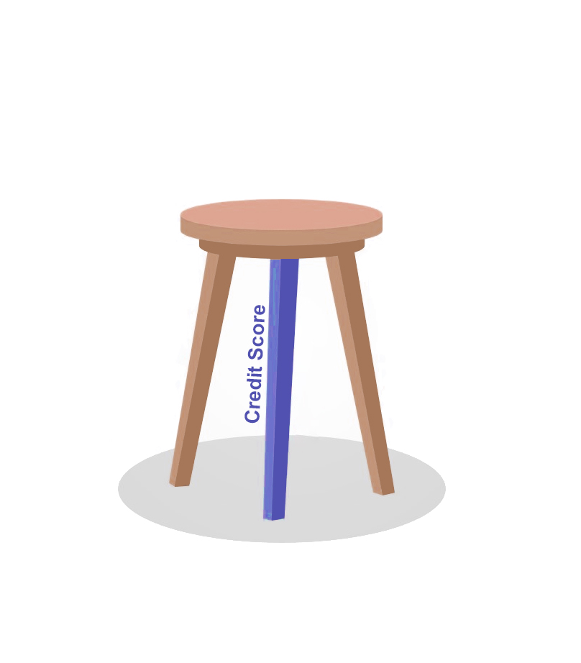
Credit Score
Bank
Very clean score required
Little tolerance for indiscretions
Alternative lenders:
Willing to accept adverse credit
Can accept a lot if security is strong

Slide 7
Security
Bank
Must be a charge against property for larger
loans
Max LTV circa 65-70%
Personal Guarantees required by default
Alternative lenders:
Will accept Personal Guarantees for up to
£500,000
Can do 2nd, 3rd or 4th charge
Can secure against assets other than property
Personal Guarantees sometimes not required

Slide 8
Other advantages of Alternative Finance
Speed
Less paperwork to complete
Interest Only/Overdraft facilities more readily available
Coming up with solutions banks would never consider
Merchant Cash Advances
Pension Led Business Finance
Flexi loans with repayments linked to turnover

Slide 9
Types of Alternative Finance
Crowdfunding
Invoice Finance/Trading
Merchant Cash Advances
Short Term Unsecured Business Loans (STUBLs)
Pension Led Business Finance
Overdraft Alternatives

Slide 10
Summary
Just because your bank can’t give you the funds you need, doesn’t mean it can’t be done
Cost will be higher than banks
Affordability – Security – Credit : one/two can be weak if the others are strong
Speak to an expert for your options

